Slide 1
Profiles and Validation
Grahame Grieve
FHIR Developer Days
November 26, 2014

Slide 2
The need for Profiles
Healthcare is a highly variable domain
Between Countries
Between Disciplines
Between different clinicians within a single practice
Between different IT implementations
There’s no single authority to set the rules

Slide 3
The need for Profiles
From RFC 2119
An implementation which does not include a particular option MUST be prepared to interoperate with another implementation which does include the option, though perhaps with reduced functionality. In the same vein an implementation which does include a particular option MUST be prepared to interoperate with another implementation which does not include the option (except, of course, for the feature the option provides.)

Slide 4
The need for Profiles
We can’t expect global interoperability
The goal of FHIR is to create a common platform or framework
It’s a small step from common implementations to interoperability

Slide 5
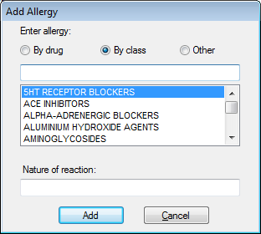
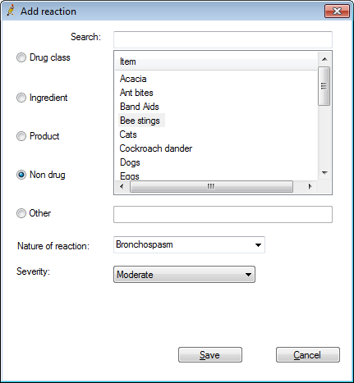
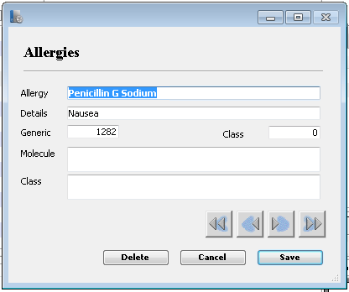

Slide 6
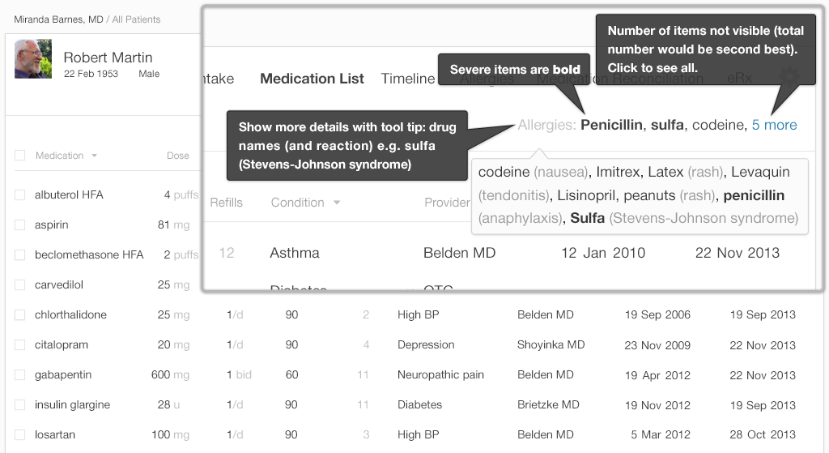
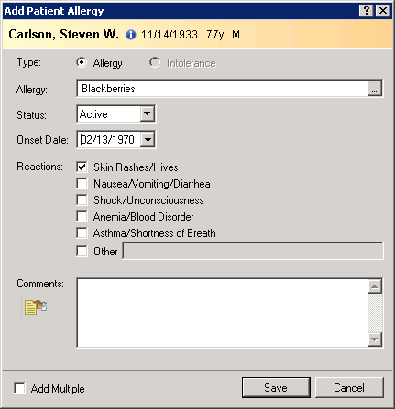

Slide 7
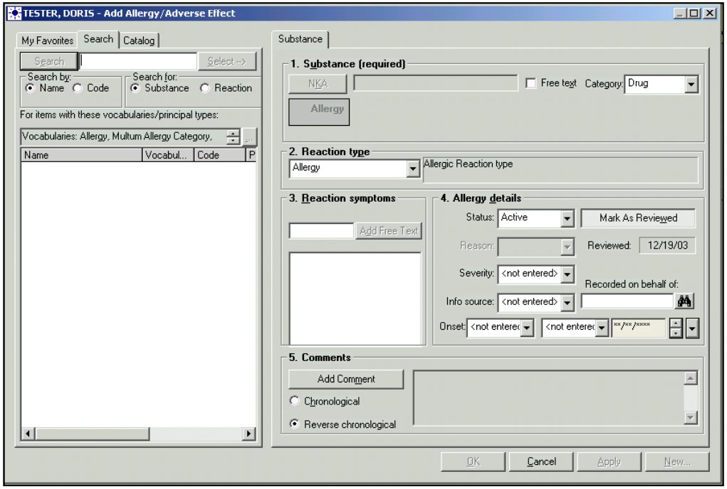

Slide 8
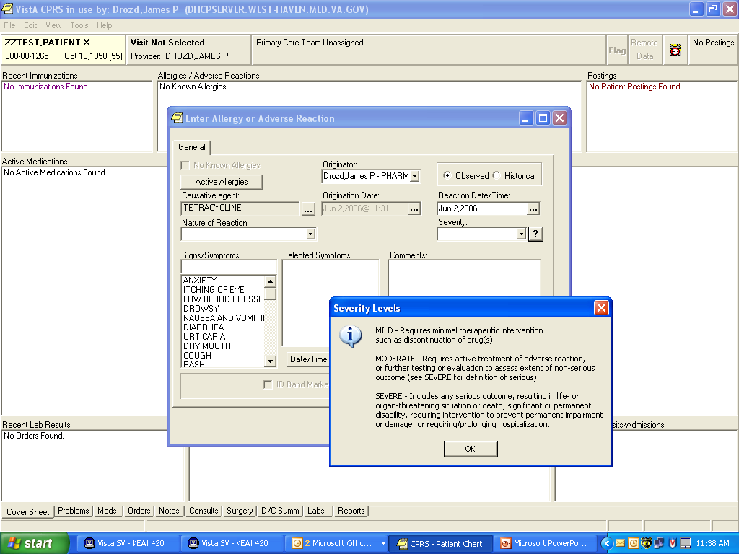

Slide 9
The last step
It’s a small step from platform from implementation
“how do you use the platform?”
The Conformance resources give the answer

Slide 10
Use cases
Application Statement of Functionality
Domain Specialist Guidance
Purchaser’s/Integrator’s statement of intent
Regional/National statement of agreements

Slide 11
Conformance Layer
Value set – definitions of codes and sets of codes
Profile – statement of how a resource is used
Conformance – statement of how a system behaves (client or server)
Concept Map – maps from one system to another (codes or fields)

Slide 12
Value Set
Describe a set of concepts
Can include codes from LOINC, SNOMED CT etc
By listing them, or by their properties
Can define their own codes
Can add descriptions to codes
Basis for a terminology service

Slide 13
Profile
Describes a set of rules about what can be in a profile
By implication, how it is used
Describes Extension (defines them and their meaning)
Describes search parameters for a resource

Slide 14
Conformance Statement
Describes what resources are supported
What operations are possible
What profiles apply to resources
What security rules apply
Required for servers
encouraged for clients

Slide 15
Profile Metadata (1)
Name | Use
identifier | Globally unique URI, OID, or UUID
version | Identify this version of the profile when it is referenced in a specification, model, design or instance. This is an arbitrary value managed by the profile author manually and the value should be a timestamp
name | Natural language name identifying the Profile
status | draft, active, retired
date | Date that this version of the profile was published
fhirVersion | Version of the FHIR specification on which this profile is based Mostly not necessary: most profiles are valid across multiple versions, validity can be checked by tooling.

Slide 16
Profile Metadata (2)
Name | Use
publisher | Individual or organization who accepts responsibility for publishing the profile
telecom | Contact details to assist a user in finding and communicating with the publisher
description | A free text natural language description of the profile and its use
requirements | The Scope and Usage that this profile was created to meet
code | A set of terms from external terminologies that may be used to assist with indexing and searching of profiles

Slide 17
Profile Contents
Metadata – context + findability
Structure 0..* - constraint on a resource or data type
Search Parameter 0..*
Extension Definition 0..*- an extension that can be used in a resource

Slide 18
Profile Structure
Name | Use
type | The Resource or Data Type being described
name | Name for this particular structure (reference target) e.g. uri#[name] to reference this structure
publish | Whether this can be used as an external reference e.g. you can define “support” structures that aren’t “entry points”
purpose | Human description of the purpose of this structure
element | Definition of the actual constraints on the elements of the type

Slide 19
Profile Structure
A linear list of Elements
Each Element has a path
The path specifies a tree of elements with a ‘.’ name e.g. Patient.contact.telecom
The type of an element can specify further contained trees e.g.
a Data Type
a reference to another part of the tree

Slide 20
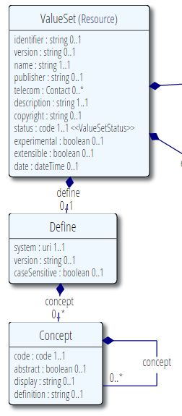
Profile Structure
ValueSet
ValueSet.identifier : string
ValueSet.telecom : Contact
ValueSet.define
ValueSet.define.system
ValueSet.define.concept
ValueSet.define.concept.concept : @ ValueSet.define.concept

Slide 21
Profile Structure
An element for each node in the path
Can’t “imply” elements
The element refers to a pre-defined resource element
Profile can’t define it’s own new data elements
Profile can “walk into” a data type
E.g. ValueSet.telecom.use

Slide 22
Structure / Element
A set of rules on the element content
Cannot define any new content the element isn’t allowed to have
Cannot revoke any rules already established in the base resource

Slide 23
Structure / Element
Cardinality – how many times the element can appear
Binding – what codes can be used (if coded)
Constraints – additional content rules
Type – restrict the contents be referring to another (profiled) type
Meanings + mappings – what the content means

Slide 24
Cardinality
Base cardinality 0..1, 1..1, 0..*, 1.. *
Can increase minimum up to max (but not *)
Can decrease maximum down to min
E.g.
1..1: can’t do anything with it
0..1: can change to 0..0 or 1..1
0..*: can change to 0..0, 0..3, 1..2 etc
1..*: can change to 1..1, 1..2, 1..3 etc

Slide 25
Binding
Elements that have codes:
code
Coding
CodeableConcept
Quantity (system + code)
All elements are “bound” to a value set – the set of codes that are allowed to be used

Slide 26
Binding Properties
Name | Use
name | Arbitrary descriptive name for the binding (should be optional, but is a tooling limitation)
description | A description of the kind of codes in the value set (optional)
isExtensible | Whether additional codes can be used
conformance | The degree of conformance associated with the binding
reference | A reference to a value set or an external standard that provides the set of codes

Slide 27
Binding Conformance
Conformance | indicates the expectations for implementers of the specification
required | Only codes in the specified set are allowed.
preferred | For greater interoperability, implementers are strongly encouraged to use the bound set of codes, however alternate codes may be used in profiles if necessary without being considered non-conformant.
example | The codes in the set are an example to illustrate the meaning of the field. There is no particular preference for its use

Slide 28
Binding Extensibility
isExtensible | indicates whether additional codes are allowed beyond those in the defined set of codes
false | No additional codes are to be used beyond the list provided
true | Supplemental codes or plain text may be needed (this is common because it is reasonable to think that concepts will need to be used which won't be in the defined set of codes)

Slide 29
Conformance vs Extensibility
Conformance | isExtensible=false | isExtensible=true
Required | Implementers SHALL use a code from the defined set | Implementers SHALL use a code from the defined set if one is applicable, but otherwise may provide their own code or use text
Preferred | Implementers SHOULD use a code from the defined set | Implementers SHOULD use a code from the defined set if one is applicable, but MAY provide their own code or use text
Example | Implementers MAY use a code from the defined set | Implementers MAY use a code from the defined set or provide their own code or use text

Slide 30
Constraining Bindings
Profiles “replace” the binding
New name, rules, value set reference
Codes that were not valid cannot become valid
Profiles can override “SHOULD”

Slide 31
Constraints
Attach to an element
Make rules about it’s content
Have a name, a human readable statement, and a machine processible format (XPath)
Can say anything that can be said in XPath
Can reference constraints from the sub elements that it affects

Slide 32
Example Constraint
Human: If you have a procedure that has a complication, it must have some follow up
A ‘business rule’ that can’t be in the base spec
Context: Procedure
XPath: not(exists(f:complication)) or exists(f:followUp)

Slide 33
Constraining the Type
Elements that do not have children defined in the profile must have a type
Type can have a profile applied
E.g. type must conform to the profile
If the resource allows multiple types, can restrict to a single type e.g. value[x] → valueString
Or to lesser set of choices e.g. string or Quantity

Slide 34
Meaning / Mapping
Profiles can change the meaning and mappings of the element
Meaning must be consistent, but can be narrower. E.g:
Can’t change “Date Time this was made available” to “Date/Time the doctor saw it”
Can change “date time this was made available” to “Date/Time posted to the portal”

Slide 35
Constraining Lists
If an element can repeat, it’s common to constrain the repeats differently:
The first code must come LOINC
First, the chemistry observations, then the microbiology ones
A blood pressure has components for Systolic and Diastolic pressures
Vital signs must have a component observation for posture, for prior exercise, and for stress estimate (e.g. children)

Slide 36
Constraining Lists
Can’t just divide the list up into different slots in the instance
General systems can’t process the data
Divide the list into “slices” – implied slots rather than explicit slots

Slide 37
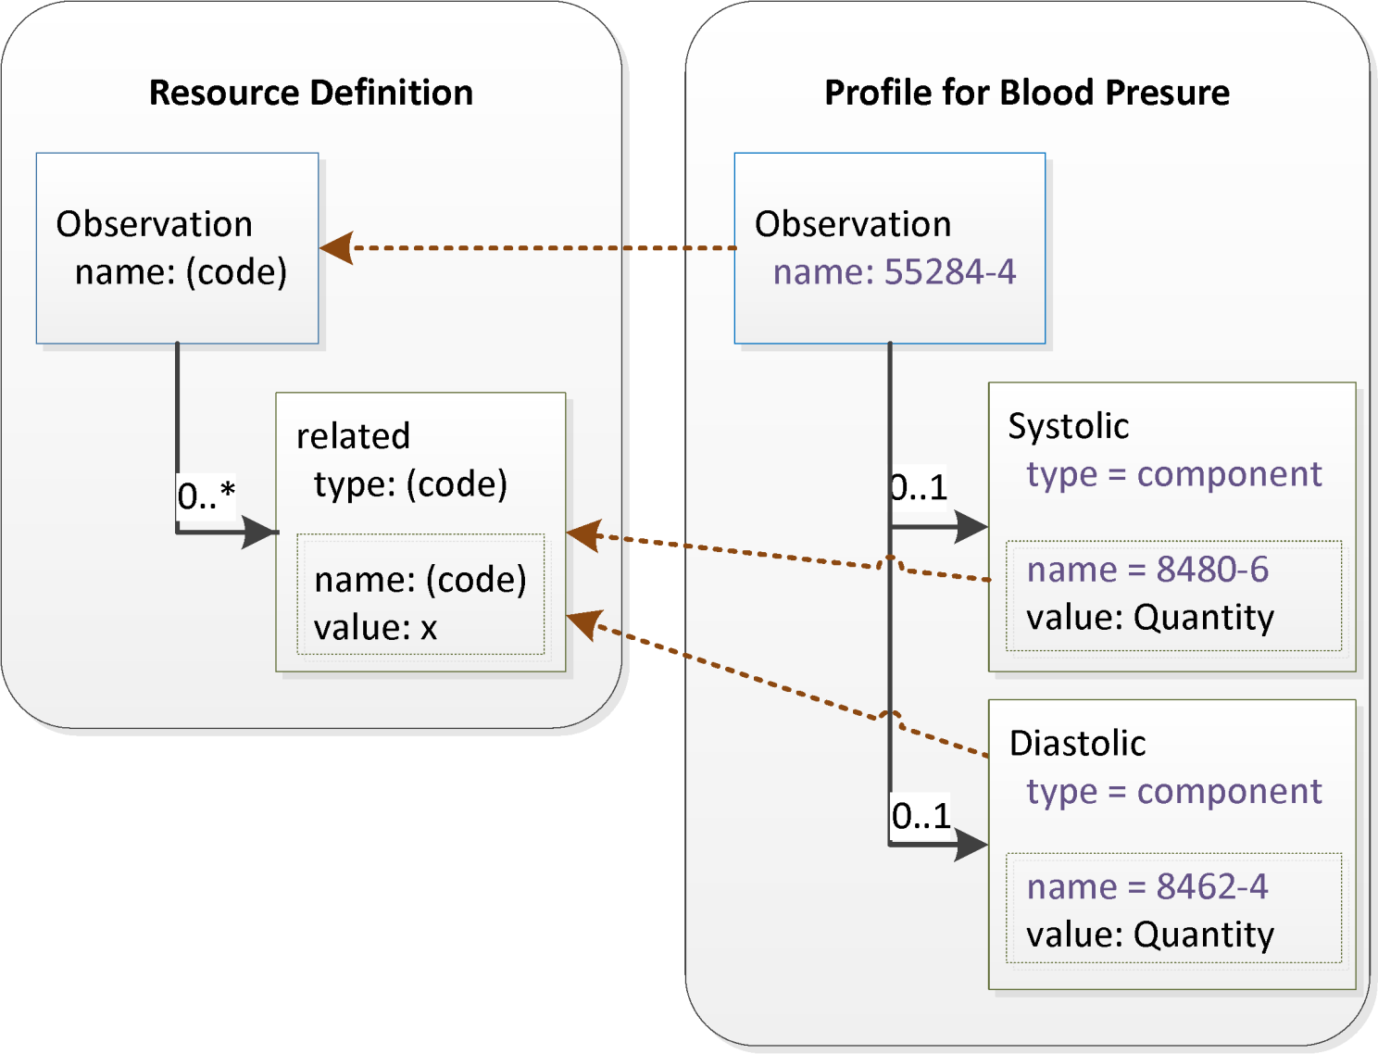
Slicing

Slide 38
Slicing
<Observation>
...
<related>
<type value="component"/>
<target ...>
</related>
<related>
<type value="component"/>
<target ...>
</related>
</Observation>
Systolic Slice
Diastolic Slice

Slide 39
Slicing
If you know about the slices, you can process by them
If you don’t know, what you don’t know won’t hurt you
But how can you tell which elements are in which slice?
Need to do this in generated code

Slide 40
Slicing Discriminator
Depth first constraint testing
Reasonably easy but computationally intensive
Hard to produce comprehensible error messages
No good for generated code
So we add a shortcut - the “discriminator”
A field that has a fixed or limited set of values that differs for each slice
E.g. switch () on the values of the field
Profile designer has to organize this

Slide 41
Slicing
discriminator | Path to the element that is holds the discriminating value
ordered | Whether the slices have to appear in the order in which they are defined (mostly, it doesn’t matter, but when it does, it’s important)
rules | Closed - No additional content is allowed other than that described by the slices in this profile Open - Additional content is allowed anywhere in the list openAtEnd - Additional content is allowed, but only at the end of the list (must be ordered)

Slide 42
Slicing in a profile
Multiple element definitions with the same path
Elements differentiated by their “name”
Name is the name of the slice
Just like you can refer to an element by path, you can refer to a slice by name and re-use it (.element.definition.nameReference)

Slide 43
Extensions
Every Element has extension : Extension 0..*
So saying that an extension must appear on an element is actually “constraining” an element
This is done by slicing the extension list with extension.url as the discriminator

Slide 44
Extensions (2)
Extensions can be prohibited by closing the extension list with no defined slices
Making an extension optional in an open list is just a reminder that it’s allowed – it’s allowed anyway

Slide 45
Extension Definition
Define an extension as a profile on the base Extension type
all the techniques we already talked about
Give it a code. URL for the extension is [profile]#[code]
Define where it can be used

Slide 46
Extension Context
Code | Definition
resource | The context is all elements matching a particular resource element path.
datatype | The context is all nodes matching a particular data type element path (root or repeating element) or all elements referencing a particular primitive data type (expressed as the datatype name).
mapping | The context is all nodes whose mapping to a specified reference model corresponds to a particular mapping structure. The context identifies the mapping target. The mapping should clearly identify where such an extension could be used.
extension | The context is a particular extension from a particular profile. Expressed as uri#name, where uri identifies the profile and #name identifies the extension code.

Slide 47
Search Parameter
Property | Meaning
name | The name to use in the URL
type | The rules around interpreting the parameter value
documentation | Description of the parameter
xpath | XPath used to extract the values (not all parameters have an XPath)
target | A list of the resource types that are possible targets (if type is a reference)

Slide 48
Summary
Profiles can “constrain” the use and meaning of the contents of a resource or type
There’s a fair bit of complexity in the fine details of the solution
Represents 20 years of work on “design by constraint”

Slide 49
Changes DSTU → Dev
Introduce Differential vs Snapshot
Decompose Profile into
Profile
ExtensionDefinition
SearchParameter
Discriminator 1..1 → 0..*
Add pattern, default value

Slide 50
Using Profiles
How to validate
Code Generation Considerations
Future tooling anticipated

Slide 51
How to validate
Schema – validates the base structure, never profiles
Schematron – could generate schematron for a profile (but don’t yet)
Java Validator
RESTful API
Web Validator

Slide 52
Java Validator
Source (from downloads page): http://hl7.org/documentcenter/public/standards/FHIR/validator.zip
Contains validator jar + base definitions + a readme
FHIRValidator.jar [source] (-defn [definitions]) (-output [output]) (-profile [profile])
Profile – file name or URL of a Profile resource

Slide 53
RESTful API
Post the resource to [base]/[type]/_validate(/[id])
Without ID: Is this resource valid?
With ID: is this a valid update
Validate against a profile: add a profile tag to the HTTP headers: Category: [url]; scheme= "http://hl7.org/fhir/tag/profile"

Slide 54
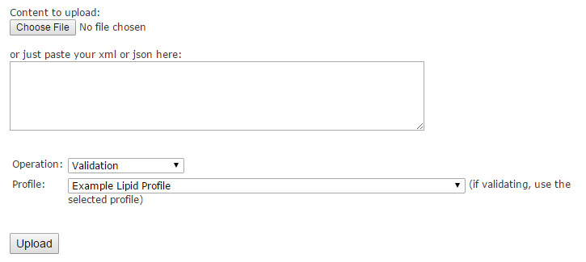
Use the Web Interface
http://fhir.healthintersections.com.au/open Go to bottom of page

Slide 55
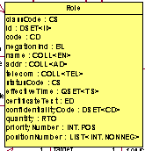
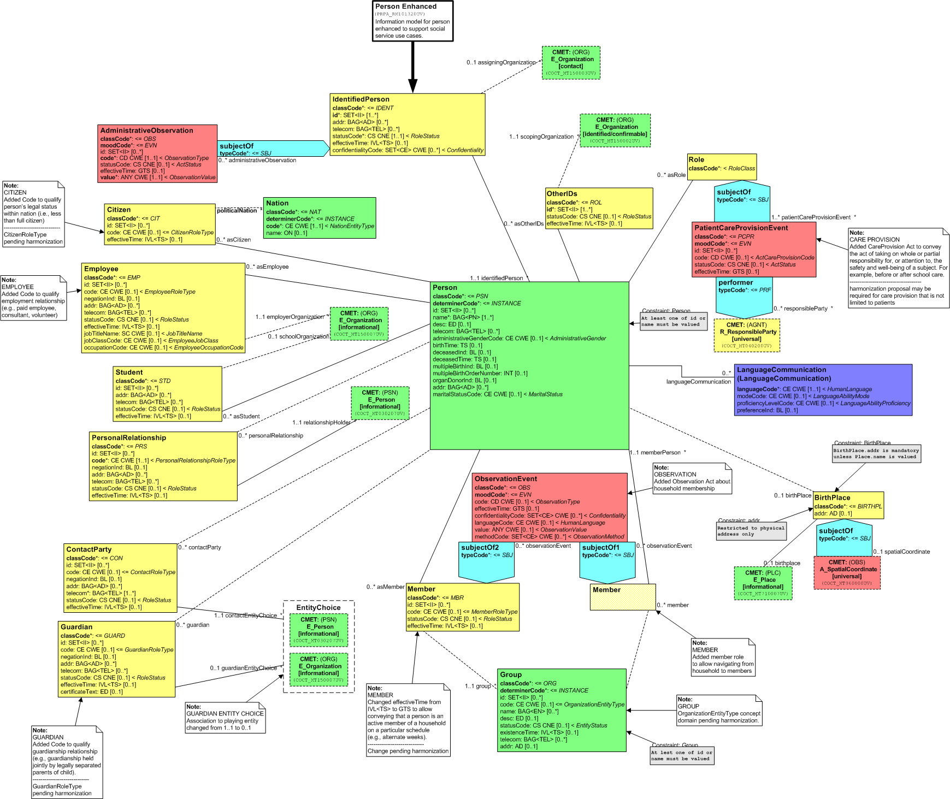
UML Theory of Profiles
This instance conforms to
all three models. Which is
the class?

Slide 56
Simple Class Model

Slide 57
“Student” as a template
?
Student is treated as a set of rules instead of a “class” definition – doesn’t take ownership

Slide 58
“Student” as a template
Use Stereotype “Student” to mark the relationship
(class or instance level)

Slide 59
“IdentifiedPerson” as a template
Use Stereotype “Student” and “IdentifiedPerson” to mark the relationships

Slide 60
OO Design theory
Design by Inheritance
Design by Composition
Design by Constraint
Which is actually design by Contract on steroids

Slide 61
Code Generation
A profile is not a “specialisation”
You can generate them that way, but it’s not a perfect fit class MyProfiledResource extends Resource
I generate them as a façade class MyProfiledResource extends ProfileWrapper constructor (Resource wrapped)

Slide 62
Future Tools
Profile Registry (desperately needed)
Profile Comparison Tooling
Do profiles overlap
Are profiles compatible
Clinical Reasoning tools using profiles + additional resources

Slide 63
Profiles
A tool for managing fractal variance
Only as successful as the community wants to make them

